Slide 1
Niagara University
M.S.Ed. Teacher Education
Elementary and Secondary Residency Program

Slide 2
M.S.Ed in Education
Online
Niagara University, Main Campus
Lewiston, NY

Slide 3
Full Time Program (100% online)
Elementary: Birth-grade 6 / primary/junior
Secondary: Grades 5-12 / intermediate/senior
Semester One
5 courses/15 credit hours
75 hours of IMPACT Experience
Semester Two
6 courses/15 credit hours
Residency I
Semester Three
Residency II
Professional Seminar course
NYS Workshops – School Violence Prevention, Mandated Reporter/Child Abuse, DASA, Drug & Alcohol Awareness
Start dates: Fall, Spring, and Summer

Slide 4
Curriculum
Elementary
First Semester
EDU 523 Foundations of Education (3 credits)
EDU 536 Human Learning, Development and Motivation (3 credits)
EDU 539 Characteristics of Students with Exceptional Needs (3 credits)
EDU 571 Foundations of Literacy Instruction (3 credits)
EDU 595 Introduction to Educational Research (3 credits)
*75 Hours Field Experiences
Second Semester
EDU 505 Measurement and Evaluation in Education (3 credits)
EDU 529 Curricular Applications in Elementary/Inclusive Education (3 credits)
EDU 530 Managing Culturally Responsive Classrooms (3 credits)
EDU 576 Integrating Language Arts in the Elementary Curriculum (3 credits)
EDU 767 Methods of Teaching Elementary/Inclusive Education (3 credits)
Residency I 400 Hours/70 Days (3 credits)
Third Semester
Residency II 600 Hours/100 Days (3 credits)
EDU 791 Professional Seminar in Elementary Education (3 credits)
Secondary
First Semester
EDU 523 Foundations of Education (3 credits)
EDU 536 Human Learning, Development and Motivation (3 credits)
EDU 539 Characteristics of Students with Exceptional Needs (3 credits)
EDU 571 Foundations of Literacy Instruction (3 credits)
EDU 595 Introduction to Educational Research (3 credits)
*75 Hours Field Experiences
Second Semester
EDU 505 Measurement and Evaluation in Education (3 credits)
EDU 577 Content Literacy Methods (3 credits)
EDU 530 Managing Culturally Responsive Classrooms (3 credits)
EDU 760 Methods of Teaching Secondary Education (3 credits)
EDU 761-66/9 Special Methods of Teaching in the Academic Subject Areas of Secondary Education (3 credits)
*Residency I 400 Hours/70 Days (3 credits)
Third Semester
Residency II 600 Hours/100 Days (3 credits)
EDU 791 Professional Seminar in Elementary Education (3 credits)

Slide 5
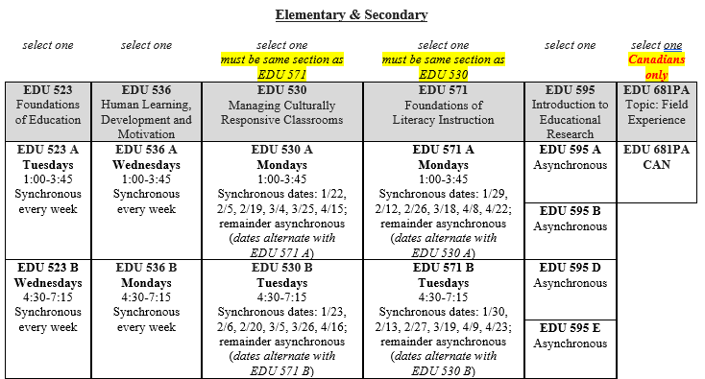
Sample Schedule Options
**All classes will be online. Courses with days and times meet as synchronous classes.
**The expectation is that you will be online the entire time for all class meeting dates. You should have your camera on and be ready to actively participate in class.
**In addition to coursework, you will have 75 hours of field experience. Your schedule for field hours will be determined with your cooperating teacher.

Slide 6
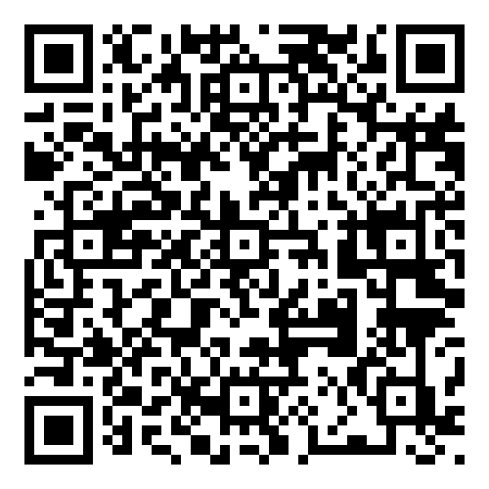
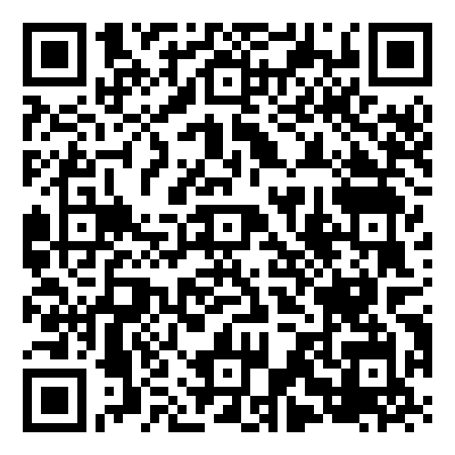
May Starter Schedule
August Starter Schedule

Slide 7
Field Placement
Our Field Placement Office facilitates placement and works with numerous school districts and boards in New York State & Ontario.
Semester #1
Impact Placement - (75 hours) Early field experience that gives students the opportunity to experience the classroom from a teacher's perspective. Mostly observation.
Semester #2
Residency I 400 Hours/70 Days (3 credits)
Semester #3
Residency II 600 Hours/100 Days (3 credits)

Slide 8
Certification
Certification Officer
Provides workshop and state testing information and vouchers
Assists students in applying for NYS certification
New York State Assessments
Educating All Students Test (EAS)
Content Specialty Test (CST)
  Secondary (Intermediate/Senior) candidates take the CST subject test in concentration area (1st teachable)
  US Elementary candidates must take both the Birth-2 Multi-Subject CST and 1-6 Multi-Subject CST
  Ontario Elementary (Primary/Junior) candidates only take the 1-6 Multi-Subject CST
New York State Certification Website
Professional Seminars
S.A.V.E (School Anti-Violence Education Workshop)
Mandated Reporter/Child Abuse Identification Workshop
Drug and Alcohol Awareness Seminar
D.A.S.A. (Dignity for All Students Act)

Slide 9
Tuition and Fees (2023-2024)
The cost per credit hour = $820 US. The total cost for the program (39 credits over 3 semesters) is approximately $31,980 USD.
Residency candidates qualify for a 25% discount on tuition (-$7,995)
$100 one-time registration fee
$110 Chalk and Wire electronic portfolio fee.
NYS test fees are additional
*FAFSA available for US-based students
* Payment plans available through Student Accounts

Slide 10
Application Standards
An earned Bachelor’s degree in any field from an accredited institution is necessary for admission to the program.
A minimum overall average of a 3.0 (70)

Slide 11
Application Requirements
Apply Online: no application fee www.niagara.edu/apply
Official Transcripts: Mailed or Emailed directly to us from institution
Official transcripts of all colleges and universities attended in a sealed institution envelope or emailed directly from institution
Electronic transcripts can be sent to grad-ed@niagara.edu
Two References: Submitted through application portal
Two references (academic, professional and/or volunteer).
Statement of Intent: Submitted through application portal
Two-page, double-spaced, typewritten statement discussing your academic and/or research background, your career goals, your personal philosophy, and how Niagara University's program will help you meet your career and educational objectives.

Slide 12
Application Requirements
Admission testing required:
Accuplacer (offered through Niagara University)
  Vouchers issued via email
  Untimed, fully multiple choice
  20 questions on arithmetic & reading, 25 questions on writing
  $25 USD for remote proctoring service
  Recommended option. The ACCUPLACER is a remotely proctored exam that can be taken on your home computer. The exam is very test-taker friendly, and includes questions related to basic skills including arithmetic, reading, and writing. All sections are multiple-choice and untimed, and individuals are able to schedule the exam 24/7 with the remote proctoring service. The proctoring fee for the test is $25 USD. The Graduate Education Office will provide a voucher for the exam once the application is submitted.
High School SAT or ACT scores
Test scores must have been taken within the last 6 years
Elementary Education
Students are required to have completed one course in each of the following:
English, Math, Science, & Social Studies from an accredited college or university (New York State Certification Requirement). These can be taken concurrently while in our program if needed at any accredited college or university
Secondary Education
Students are required to have 36 credit hours in their first teachable
  * Canadian only: 18 credit hours in their second teachable

Slide 13
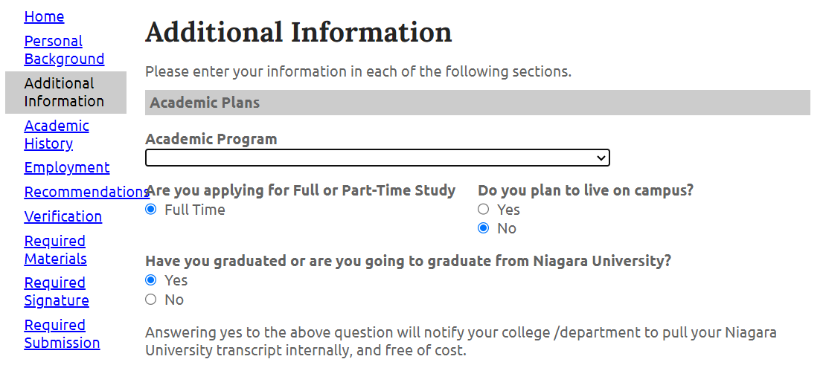
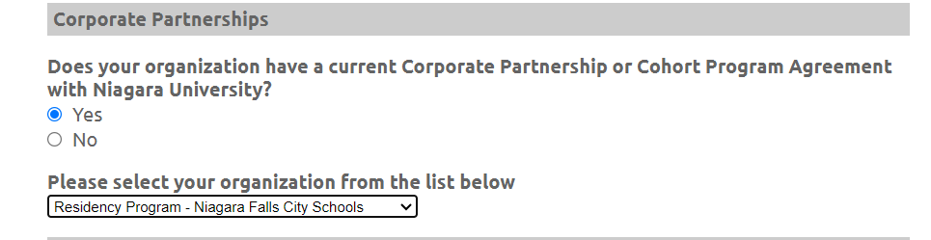
Residency Program

Slide 14
Application Requirements
Additional Requirements International
A degree evaluation by WES (www.wes.org) or Spantran is required for applicants who have obtained a degree outside of the United States or Canada. Please select the comprehensive course-by-course report.
For individuals whose native language is not English, a language proficiency examination is required. Please visit www.niagara.edu/toefl-requirements for more information.

Slide 15
Application Timeline
Applications are accepted on a rolling basis, meaning we continue to review and accept qualified applicants as files are completed.
It is always recommended to apply early to secure your seat if admitted.
Applications are open for
Summer 2024 (begins mid-May)
Fall 2024 (begins late August)

Slide 16
Contact Information
Paula Prohaska
Graduate Intake Coordinator
716 286 8336
grad-ed@niagara.edu

Slide 17


Slide 18


Thank You!

